Slide 1
CSE 3100: Systems Programming
Lecture 9 : Input/Output and Files
Professor Kaleel Mahmood
Department of Computer Science and Engineering
University of Connecticut

Slide 2
Even More Midterm Information
Two parts. Multiple choice and coding. The multiple choice is 30%, coding questions are 70%.
A practice exam will be given in class Monday 2/19/2024. Bring your laptop.
Exam Review Session by the TAs Thursday 2/22/2024 from 5:30 to 6:30 p.m. at AUST 105

Slide 3

Review of Some Previous Lecture Concepts…

Slide 4
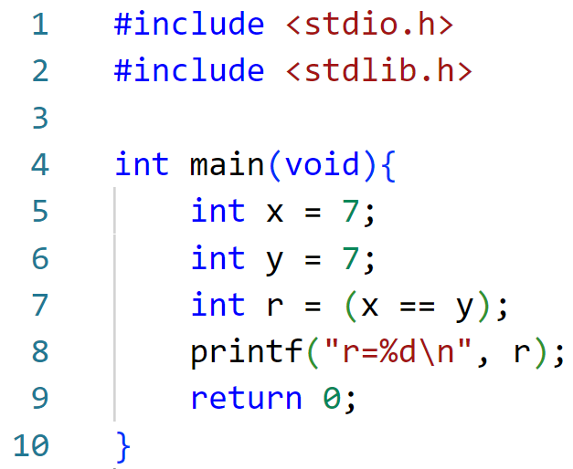

Question 0: What will be printed? A) r=7 B) r=0 C) r=1

Slide 5
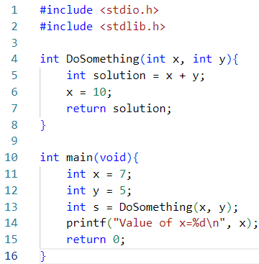

Question 1: What will be printed? A) x=10 B) x=7
Why? Primitives are passed by VALUE to functions.

Slide 6
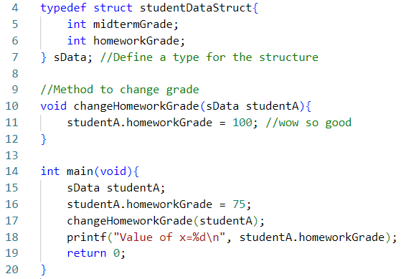

Question 2: What will be printed? A) x=75 B) x=100
Why? Structures variables are passed by VALUE to functions.

Slide 7
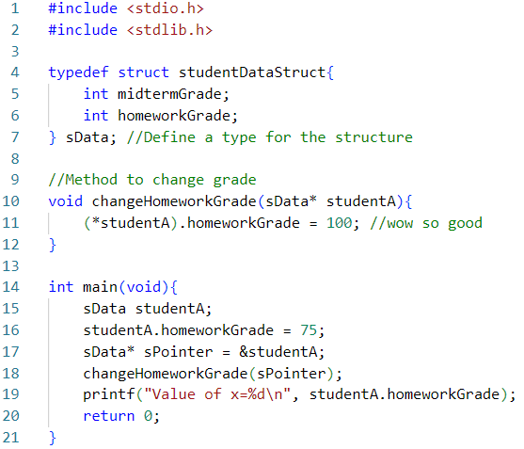

Question 3: What will be printed? A) x=75 B) x=100
Why? The pointer to the structure allows us to manipulate the original variable.

Slide 8
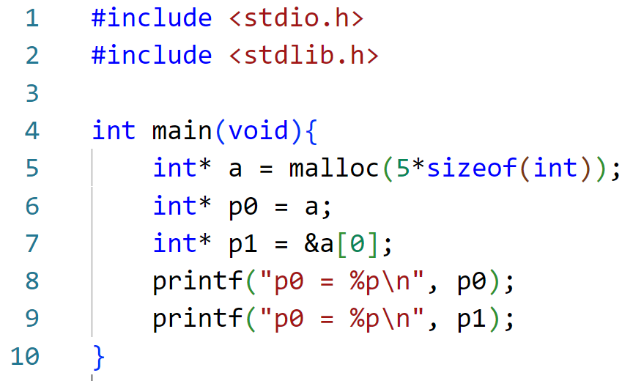
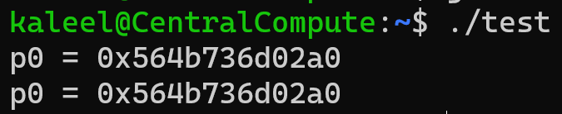
Question 4: Are p0 and p1 the same? A) Not same. B) Same.

Slide 9
1. Error Handling
Today’s Lecture Topics
2. Files and Input/Output

Slide 10
1. Error Handling

Slide 11
errno
Most C library functions can “fail”
When they do, they return a flag reporting failure… (-1)
Some set a global variable to report the exact error code
errno
// To use errno, include <errno.h>
Check manual page to interpret the error code
Print a more descriptive message with perror()
void perror(const char *str);

Slide 12
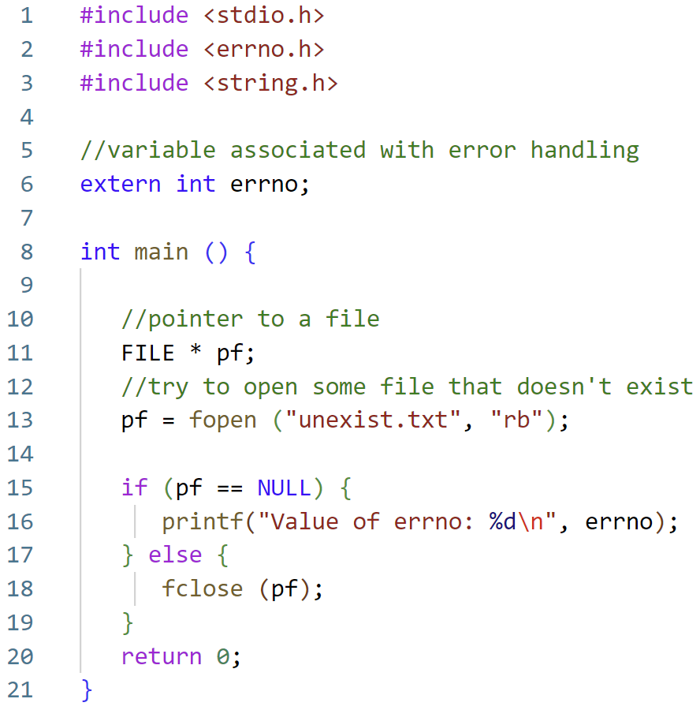
Error Example
Code Example From: https://www.tutorialspoint.com/cprogramming/c_error_handling.htm

Slide 13
Error Example
Try to open some file that doesn’t exist.
We want to create an error on purpose to see the value of errno that is printed out.
Code Example From: https://www.tutorialspoint.com/cprogramming/c_error_handling.htm

Slide 14
Error Example
If we don’t have the file (NULL) then print out the value of errno.
Otherwise just close the file.
It is important to note: in this example we DO NOT have the file (on purpose).
Code Example From: https://www.tutorialspoint.com/cprogramming/c_error_handling.htm

Slide 15


Error Example
Errno #2
C Programmer
Code Example From: https://www.tutorialspoint.com/cprogramming/c_error_handling.htm

Slide 16
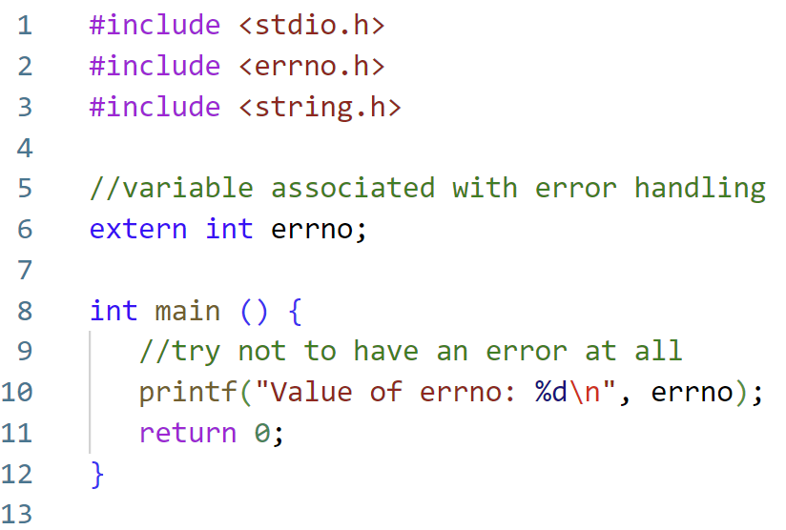

Error Example: What does no error look like?
Ok so we know 0 means no error. But do we want to actually memorize all the C error codes?

Slide 17
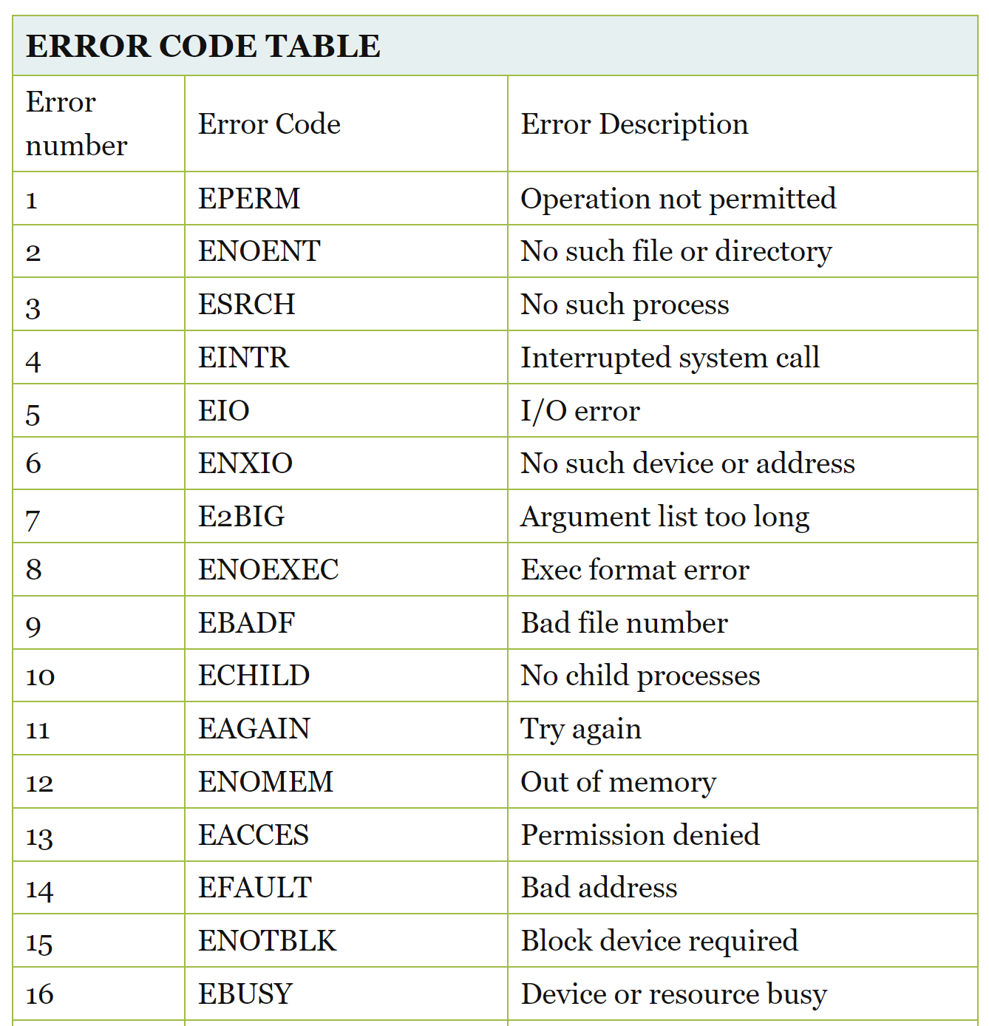
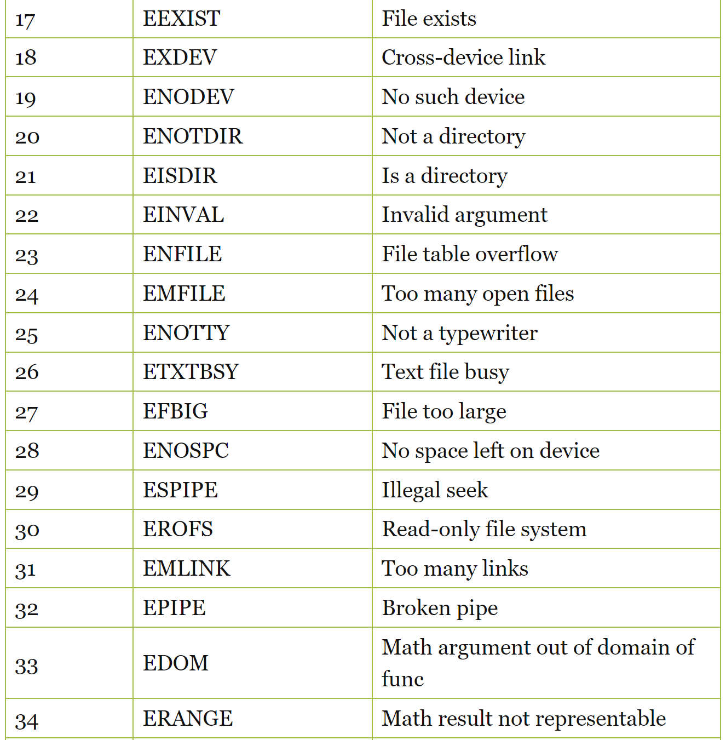

Do we want to actually memorize all the C error codes?
Yes. For the exam I will ask you to write all 131 error codes from your own memory (first 34 shown here):
Just kidding!

Slide 18
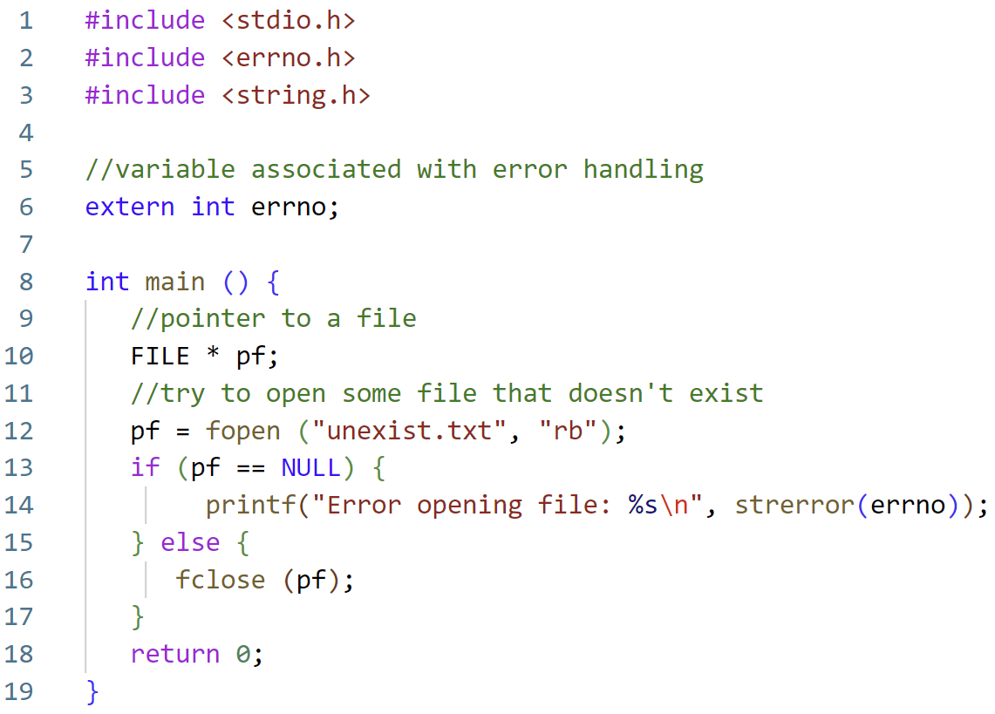

A more readable error message:

Slide 19
2. Files and Input/Output

Slide 20

Files and Directories
A file is an object that stores information, data, etc.
Example:
Files you create with an editor (.c, .h, Makefile, readme, etc.)
Executable generated by the compiler, and gcc itself
Other devices, like screen, keyboard, …
In Linux, files are organized in directories
A directory can have subdirectories and files
The top directory is /
A path specifies the location of file/directory in the file system
/home/john
In Unix/Linux, everything is a file
A file
A file
A file
Files

Slide 21
The stdio library
#include <stdio.h>
Declares FILE type and function prototypes
FILE is an opaque type (system dependent) for operating on files
It is a structure, but do not try to change it directly!
Use library functions to access FILE objects, via pointers (FILE *)
Defines “standard” streams stdin, stdout, stderr
Created automatically when program starts
They are files!
The library is linked automatically by the compiler
They are FILE *

Slide 22
Files and I/O API
In C, a file is simply a sequential stream of bytes
The “f” family of functions (fopen, fclose, fread, fgetc, fscanf, fprintf,…) are C library functions to operate on files
All these use a FILE* abstraction to represent a file
The C library provides buffering
That's why sometimes you do not see output of printf immediately

Slide 23
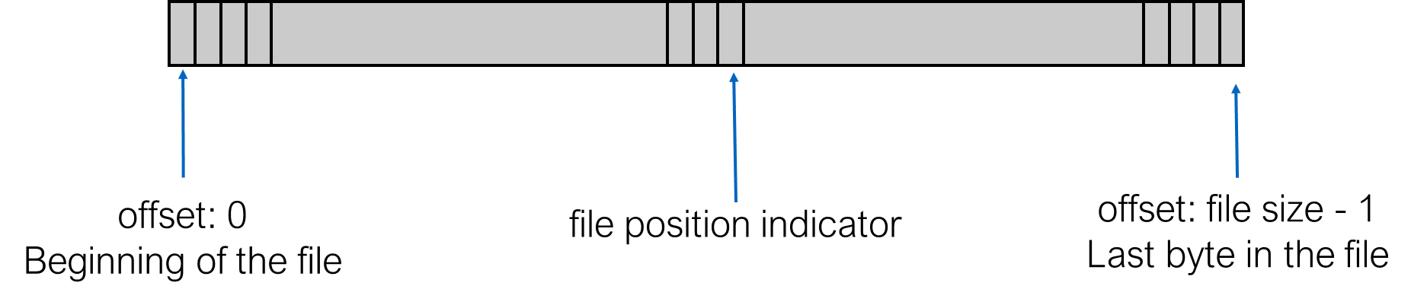
File as stream of bytes
Before use a file must be “open”
This sets a position indicator for reading and/or writing
Each read/write starts from current position, and moves the indicator
Writing after last byte increases the file size
Position indicator can also be changed with fseek
All open files are closed when program ends
Good practice to close explicitly when no longer needed

Slide 24
Opening Streams
FILE* fopen( const char *filename, const char *mode);
Open the file filename in mode as a stream of bytes
Returns a pointer to FILE (FILE *) or NULL (and errno is set)
Mode
“r” : Reading mode
“r+” : Read and write
“w” : Writing mode, file is created or truncated to zero length
“w+” : Read and write, but the file is created or truncated
“a” : Append mode, the file is created if it does not exist
“a+” : Read and append, the file is created if it does not exist. Reading starts at beginning, but writing done at the end

Slide 25

Closing Streams
a file
int fclose(FILE *stream);
Close a stream
Returns
0 if it worked
EOF if there was a problem (and errno is set)

Slide 26
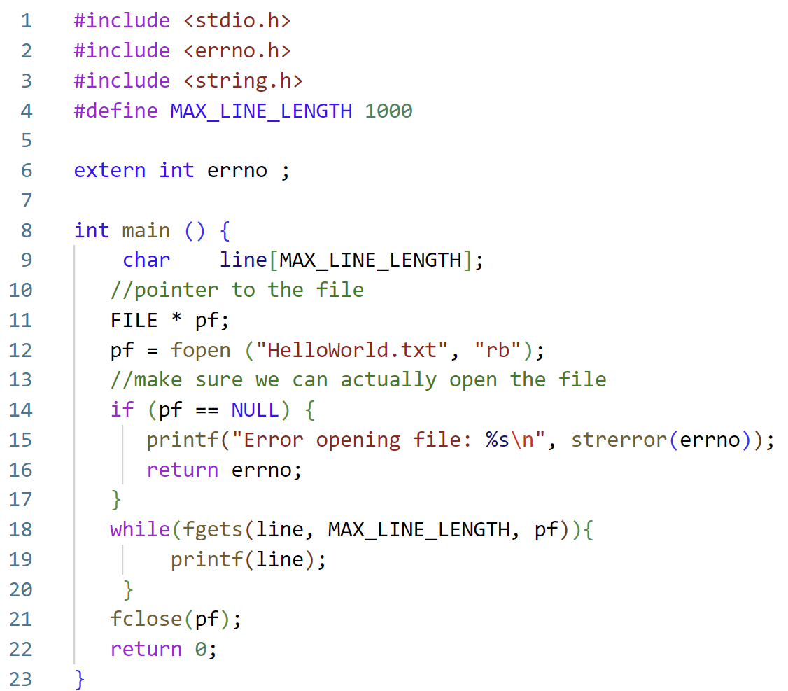
Simple File Reading Example
Read in a maximum number of character lines from a text file.

Slide 27

What does the file “HelloWorld.txt” look like?
HelloWorld.txt
When you create a very complicated file:
Hello
World
My
Name
Is
Apple

Slide 28
Simple File Reading Example
Error handling as we previously discussed, make sure the file is readable.

Slide 29
Simple File Reading Example
Create a file pointer and use fopen to point to the file.
Use fgets to keep reading lines of the file until we reach the end or max length.

Slide 30
Who is fgets?
char *fgets(char *str, int n, FILE *stream)
The C library function char *fgets(char *str, int n, FILE *stream) reads a line from the specified stream and stores it into the string pointed to by str.
It stops when either (n-1) characters are read, the newline character is read, or the end-of-file is reached, whichever comes first.
Source: https://www.tutorialspoint.com/c_standard_library/c_function_fgets.htm

Slide 31
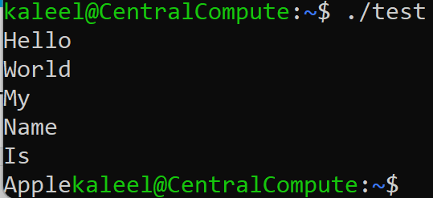
Simple File Reading Example

Slide 32
Byte Sized Reading
In the previous coding example we looked at reading an entire line.
What if we want to read bytes at a time?
int fgetc( FILE *stream);
int fputc(int c, FILE *stream);
Read or write one (ASCII) character (8-bits) at a time
Can be slow for large files
fgetc reads a character from the stream and returns the character just read in (as unsigned char extended to int)
Returns EOF when at the end of file or on error
fputc writes the character received as argument to the stream and returns the character that was just written out
Returns EOF on error

Slide 33
getc / putc and ungetc
int getc(FILE *stream);
int putc(int c, FILE *stream);
Same as fgetc/fputc except they may be implemented as macros
Use fgetc/fputc unless you have strong reasons not to
int ungetc(int c, FILE *stream);
Pushes last read char back to stream, where it is available for subsequent read operations
Only one pushback guaranteed

Slide 34
getchar / putchar
int getchar(void)
// same as fgetc(stdin)
Reads a character from stdin
Returns the character just read in, or EOF on end-of-file or errors
int putchar(int c)
// same as fputc(c, stdout)
Writes the character received as argument on stdout
Returns the character that was just written out, or EOF on errors

Slide 35
Formatted output
int fscanf(FILE *stream, const char *format, ...);
int fprintf(FILE *stream, const char *format, ...);
Formatted input from file and output to file
Like scanf()/printf(), but not from stdin or to stdout

Slide 36
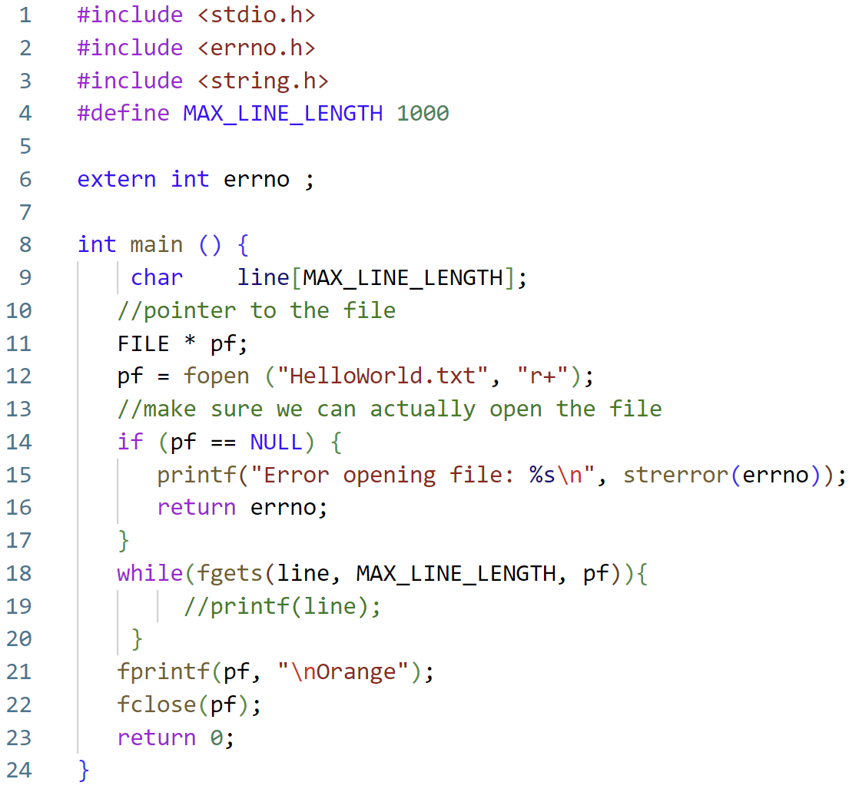

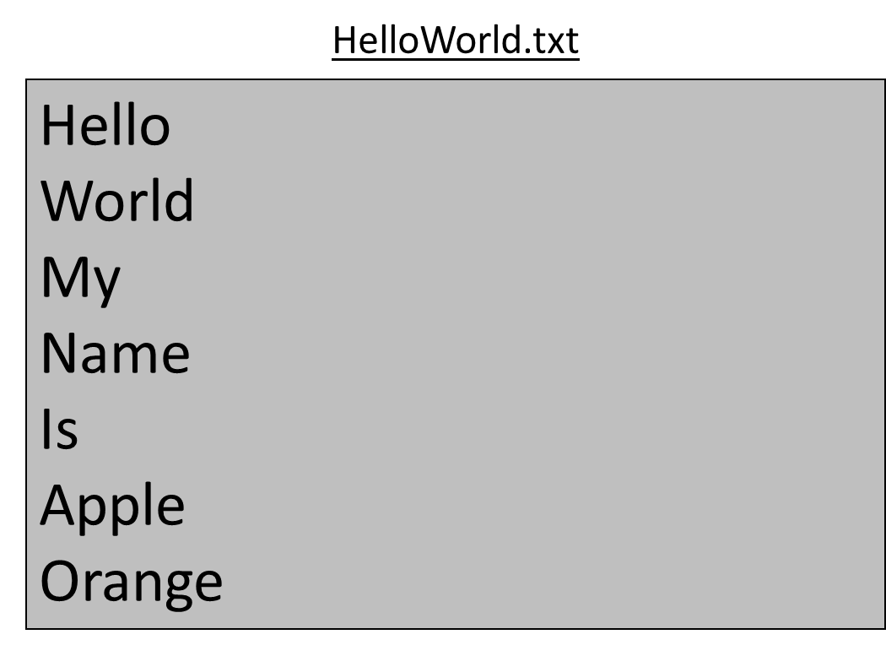
Fprintf Example
BEFORE the code is run.
AFTER the code is run.

Slide 37
Moving file position indicator
long ftell(FILE *stream);
Read file position indicator
Return -1 on error
int fseek(FILE * stream, off_t offset, int whence);
Set the file position indicator
Return 0 on success and -1 on error
Example:
fseek(fp, 0, SEEK_SET); // move to the beginning
fseek(fp, 200, SEEK_CUR); // move forward 200 bytes
fseek(fp, -1, SEEK_END); // move to the last byte

Slide 38
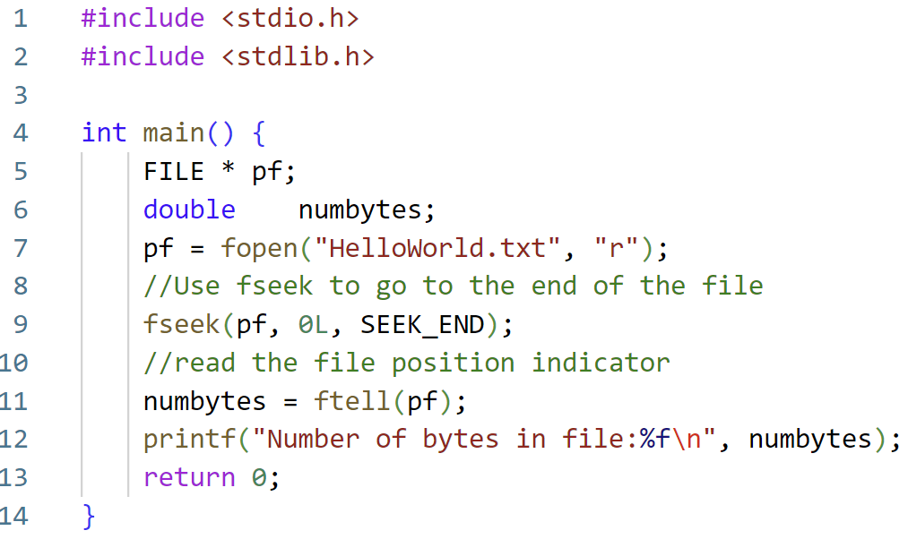

Code Example: Finding the size of a file
Source: https://www.tutorialkart.com/c-programming/c-read-text-file/

Slide 39
Related I/O Function Slides
//Check if end-of-file is set (after a read attempt!)
int feof(FILE * stream);
//Force write of buffered data
int fflush(FILE * stream);
int fputs(const char *str, FILE *out)
Writes the string str to out, stopping at ‘\0’
Returns number of characters written or EOF
size_t fread (void *ptr, size_t sz, size_t n, FILE *stream);
size_t fwrite(void *ptr, size_t sz, size_t n, FILE *stream);
Read / write a sequence of byte from/to a stream
Return the number of items read or written
If smaller than n, EOF or error

Slide 40
Figure Sources
https://cdn.vox-cdn.com/thumbor/VKx8R0U9BKwV9SE2_eaVwJtywjU=/0x0:500x375/1400x1050/filters:focal(158x110:238x190):format(jpeg)/cdn.vox-cdn.com/uploads/chorus_image/image/59741997/n4scgse21iuz.0.jpg
https://www.thegeekstuff.com/2010/10/linux-error-codes/
https://i.kym-cdn.com/photos/images/facebook/001/100/963/ab8.jpg
http://www.quickmeme.com/meme/3upt4q
https://live.staticflickr.com/699/32421179826_69211d9189_b.jpg
https://external-preview.redd.it/6oAehEdLMEkhf2vzyahMneljSakPn7PvkG-KmykG7UY.jpg?auto=webp&s=47c3d3654cfe2b078a809c3d41d62ec60be1ecb2

